Slide 1
SELF-ORG.CHEM
This presentation is protected by international copyright laws. The material here contained cannot be copied in any form unless expressively authorized in writing by its copyright owner and is intended for educational purposes only. License is extended only to the individual purchaser. All rights reserved
© Miguel E. Alonso-Amelot 2011

Slide 2
SELF-ORG.CHEM
WHAT DO YOU WANT TO DO?
GO TO INSTRUCTIONS
GO TO LECTURE
CLICK ON BUTTON OF YOUR CHOICE

Slide 3
SELF-ORG.CHEM
1
THE ART OF DRAWING ORGANIC COMPOUNDS

Slide 4
SELF-ORG.CHEM
2
IN THIS LECTURE:
CLICK HERE
Molecules and drawing types: from empirical to three dimensional
Aliphatics: Explicit Hydrogens vs abbreviated line rendering:
Drawing aliphatic compounds and branching
Drawing aromatics, planar structures
Drawing alicyclics and the problem of non-planarity on paper
A sophisticated example: the cocaine molecule
24+ slides, approx time: 60-90 min

Slide 5
SELF-ORG.CHEM
3
3
SEVERAL TYPES OF MOLECULAR RENDERINGS FOR EVERY COMPOUND
C₇H₁₂N₂O
Empirical formula Atomic composition
Molecular orbitals
Atom connexions
Partial Charge
distribution
Spatial distribution
…and others…
Ball & stick

Slide 6
SELF-ORG.CHEM
4
4
CARBON SKELETONS: THE MOLECULAR CHASSIS
Drawing molecules = placing atoms and bonds correctly
C
C
…..
C
C
O=C—C—N--
Open-chain (aliphatic)
CARBON BACKBONES
Aromatic rings
Cyclic compounds
Saturated carbon Rings (alicyclic)

Slide 7
Building our first molecule
SELF-ORG.CHEM
5
Iso-butanol
CH, CH₂, 2xCH₃, OH
Group composition
C₄H₁₀O
Empirical formula: atomic composition
Condensed formula 1: minimum connectivity
Expanded formula 2: better look at connectivity
CH₃
OH
Line structures or abbreviated line rendering, most useful and used universally
CH
CH₂

Slide 8
3-D RENDERINGS
SELF-ORG.CHEM
6
Iso-butanol
Stick or wire model
Space-filling model showing Van der Waals volumes
= H
= C
Color codes of elements
= O
= N
= Cl
Ball & stick model
= S

Slide 9
SELF-ORG.CHEM
3-D SPECIAL CASES
7
Atoms
Partial electronic charges
Electronic “envelope”

Slide 10
SELF-ORG.CHEM
THE ABBREVIATED LINE RENDERING:
8
Branched aliphatics
Empirical formula C₂₄H₄₈O₃…
Classical condensed CH₃CH₂CH(CH₃)CH(C₂H₅)C(CH₃) C…. gosh!
LINE ABBREVIATED LINE STRUCTURE:
O
A cleaner look
OH
HO

Slide 11
SELF-ORG.CHEM
THE MOLECULAR LINE RENDERING
9
Drawing aliphatic carbon backbones
n-PENTANE: C₅H₁₂
5x2 + 2 = 12 H (saturated C)
Condensed structure
Line structure:
H
terminal methyls
C
109º
C
C
H
C
H
CH₃CH₂CH₂CH₂CH₃
=
H
C
Saturated carbon
Methylenes

Slide 12
Drawing an aliphatic alcohol
SELF-ORG.CHEM
10
QUICK QUIZ
n-hexan-1-ol: C₆H₁₄O
Draw in line abbreviated form
6
4
2
6 5 4 3 2 1
5
3
1
Alcohol unit or carbinol
Carbon numbering
5
You have 30 sec
30
10
Click mouse to start clock
FLUNKED!
25
15
20

Slide 13
DRAWING LINE STRUCTURES OF MORE COMPLEX ALIPHATICS AND OTHER COMPOUNDS
SELF-ORG.CHEM
C₁₂H₂₄O
11
STEPS
8
7
6
5
4
3
2
1
1
Identify the molecular backbone forming the longest chain (magenta units above)
2
Count carbons and determine length of main chain
Assign numbers to main chain carbons from right to left
3
Substituents branching off appear in parenthesis (yellow atoms above)
4
Draw the line connections (bonds) based on the purple C and ignore all atoms except heteroatoms

Slide 14
Putting the four steps to work
SELF-ORG.CHEM
12
8
7
6
5
4
3
2
1
1
branches
RECOGNIZE BACKBONE
CH₃O
2
COUNT & DRAW
backbone
1
6
7
5
3
3
ADD SUBSTITUENTS
8
4
2
4
DONE!

Slide 15
Line structures in non linear shapes
SELF-ORG.CHEM
13
CH₃O
All depict the SAME compound
CH₃O
TEMPLATE
Other ring-template renderings

Slide 16
SELF-ORG.CHEM
14
Templates for drawing natural products
GERANIOL
Beta FARNESENE
NEROLIDOL

Slide 17
SELF-ORG.CHEM
Building more complex aliphatics
15
Example 1
H
CH₃
NH₂
N
Example 2
COOH
S
OH

Slide 18
SELF-ORG.CHEM
16
DRAWING MULTIPLE BONDS IN ALIPHATICS
Four kinds of multiple bonds in aliphatics:
ALKENES
1
C=C
ALKYNES
2
C≡C
C≡N
NITRILES
KETONES
3
C=O
4
C=O (end)
aldehydes
carboxylates
esters

Slide 19
SELF-ORG.CHEM
17
DRAWING FUNCTIONALIZED ALIPHATIC ALKENES/ALKYNES
8
7
6
5
4
3
2
1
O
4
2
OCH₃
8
7
3
1
6
5
O
COOCH₃
CN
O
ALSO DRAWN AS:
CN

Slide 20
SELF-ORG.CHEM
18
DRAWING AROMATICS
Classic drawing
of benzene
Modern rendering
of benzene
Fused aromatic rings
Substituents
on rings
More complex
polycyclics
Hetero-
aromatics
Nicotine

Slide 21
SELF-ORG.CHEM
19
DRAWING ALICYCLICS
3-membered: cyclopropanes
4-membered: cyclobutanes
Bicyclics
5-membered: cyclopentanes
6-membered: cyclohexanes
Functionalized
polyclics
7-membered: cycloheptanes
8-membered: cyclooctanes

Slide 22
SELF-ORG.CHEM
20
COMBINING ALIPHATIC, AROMATIC & ALICYCLIC CARBON BACKBONES
2
Add functional groups
1
Draw backbone
Cholesterol in your arteries & tissues

Slide 23
SELF-ORG.CHEM
21
FLAT AND 3-D MOLECULES: THE MOLECULAR PLANE
PLANAR (2-D) MOLECULES: AROMATICS
BENZENE
Molecular plane
TILTING BENZENE…
Also planar:

Slide 24
SELF-ORG.CHEM
22
NON-PLANAR ALICYCLICS: A BRIEF VIEW
CYCLOHEXANE IN 3D
CONFORMATIONAL ANALYSIS
ABOVE (the beta side)
1,3-DIMETHYL CYCLOHEXANE
Molecular plane
BELOW (the alpha side)
TILTING CYCLOHEXANE…
is…

Slide 25
SELF-ORG.CHEM
23
NON-PLANAR ALICYCLICS: A BRIEF VIEW
FUSED CYCLES IN 3D
Good rendering but…
For example…
up
up
down
These groups need to be defined whether up or down the molecular plane
If not defined, use
wiggled or straight lines

Slide 26
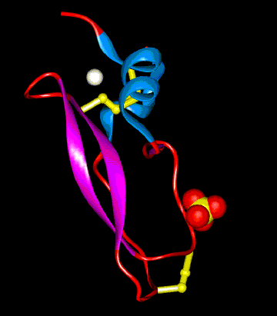
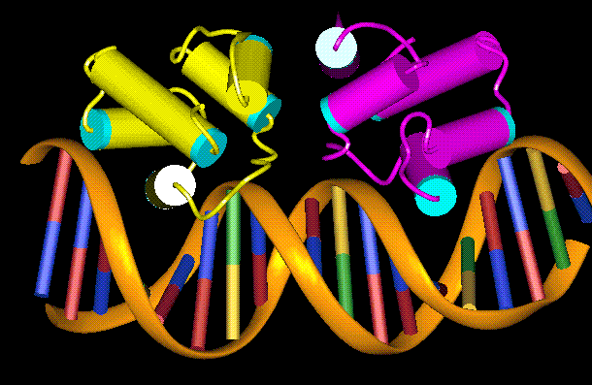
SELF-ORG.CHEM
COMPUTER SOFTWARE
24
2.49 Å
3.28 Å
107º
A protein ribbon model
A protein-DNA complex model
Protein Images created by the Structural BioInformatics Group Imperial College, London

Slide 27
END OF THIS LESSON
SELF-ORG.CHEM
PLEASE MAKE YOUR SELECTION:
Back to menu
QUIT
Do you want to go over an advanced exercise in molecular rendering: the structure of cocaine?, click here
Go

Slide 28
SELF-ORG.CHEM
CONTEMPORARY MOLECULAR RENDERINGS
ANEX 1
COCAINE

Slide 29

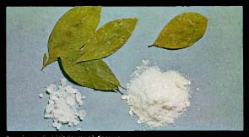
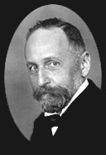
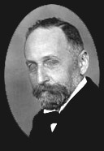
SELF-ORG.CHEM
A-2
Erythroxilon coca
Erythroxiline
Dry coca leaves
C₁₇H₂₁NO₄
Richard Willstätter 1872-1942
CH
COOCH₃
H₂C
CH
CH₃N
H₂C
CH
Benzoate
CH
CH₂
COCAINE condensed structure
Public domain pictures

Slide 30
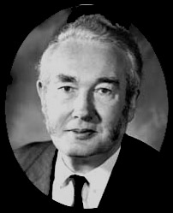
SELF-ORG.CHEM
A-3
Renderings of the Cocaine molecule
C₁₇H₂₁NO₄
Empirical formula
Sir Derek Barton 1918-1998
Line-abbreviated bicyclic structure
carboxymethyl
methylamino
Line Abbreviated 3-D structure
benzoate

Slide 31
SELF-ORG.CHEM
MORE ABOUT THE 3-D STRUCTURE
A-4
3-D view… a bit confusing
Practice + practice +…
more practice…
Splitting model in sections

Slide 32
SELF-ORG.CHEM
A-5
ULTRAMODERN COMPUTATIONAL RENDERING OF COCAINE
photo-realistic molecular renderings
Source: http://www.merl.com/people/perry/NPR_ADF_TR.pdf Ronald Perry and Sarah Frisken. Mitsubishi Electric Research Laboratories,

Slide 33
SELF-ORG.CHEM
If this example seemed too difficult for you do not worry now. I just wanted to push you to your limits through a demanding ride. In time and lots of practice, this will appear quite easy to you
END OF MODULE
BACK TO MENU
QUIT

Slide 34
INSTRUCTIONS FOR THIS PRESENTATION
© SELF-ORG.CHEM
These slides are highly dynamic with sophisticated effects especifically designed for effective teaching-learning .
You control movements and other effects either by waiting them to show or by clicking with keypad keys or mouse buttons, as usual.
The Script contains the exact accompanying comments for the speaker for each slide and its effects.
NEXT

Slide 35
Nº
HOW TO HANDLE THIS LECTURE
When all the visuals are shown on screen a hexagon on the upper right corner will appear around the slide Number.
This will tell you that the next click of the mouse will drive you to the next slide (or use the buttons at the bottom right)
So please review this presentation before class along with the script and become familiar with effects for maximum performance
NEXT

Slide 36
SELF-ORG.CHEM
HOW TO HANDLE THIS PRESENTATION
At the bottom-right there is a set of action buttons to jump to distant slides, restart or quit:
Go to subject index of module
Go to slide Nº 1 of current subject
Go back to preceding slide
Move on to next slide
Go to the last slide of current chapter
Quit current lecture
GO TO LECTURE

